Slide 1

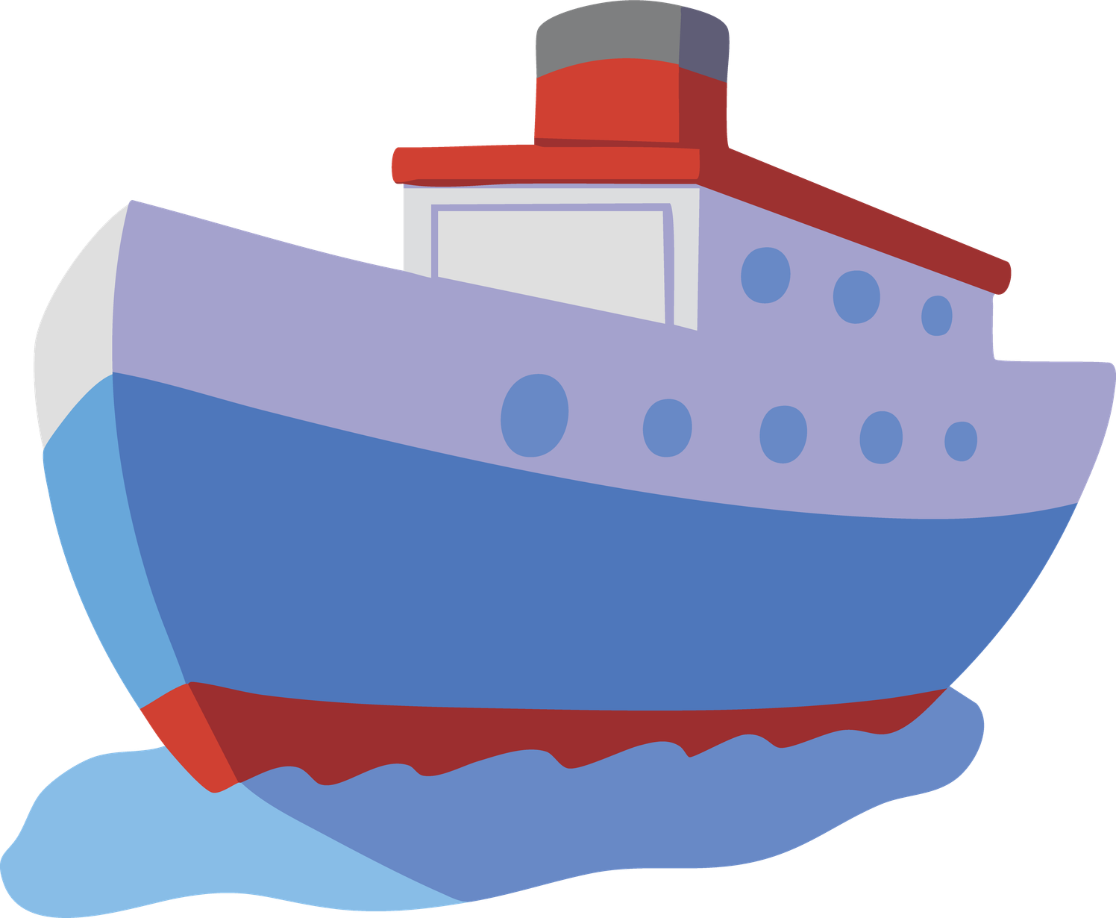


Ships
Masters Of The Seas

Slide 2
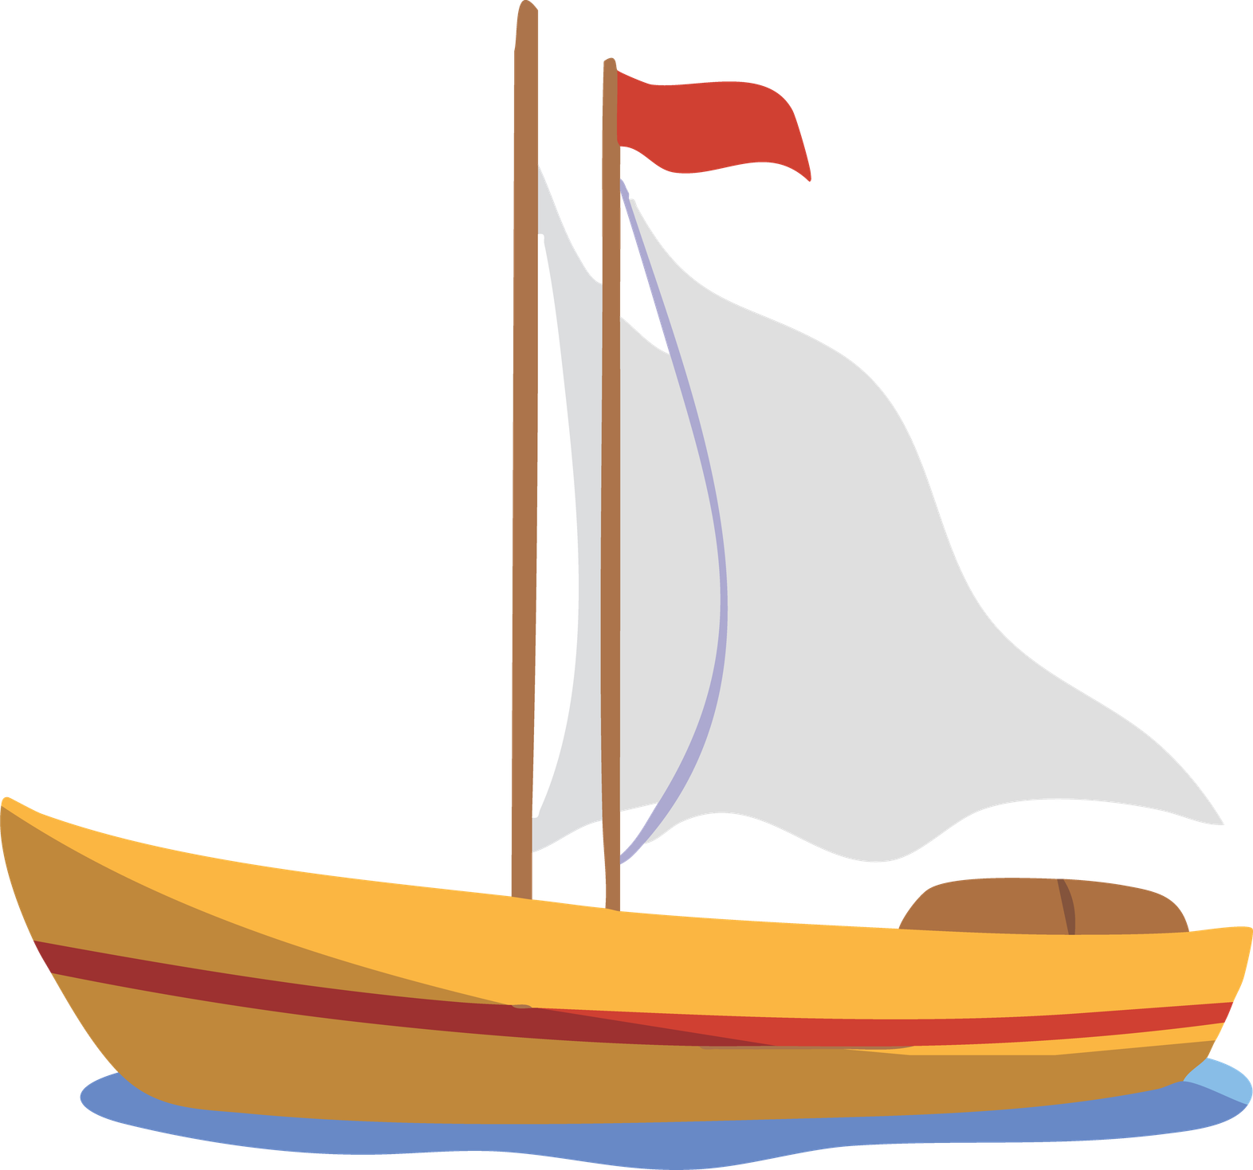
Introduction To Ships
Ships are large watercraft designed to transport people, goods, and resources across oceans, rivers, and lakes. Throughout history, they have played a crucial role in exploration, trade, and cultural exchange. Modern ships continue to connect nations while supporting global commerce and transportation networks.

Slide 3
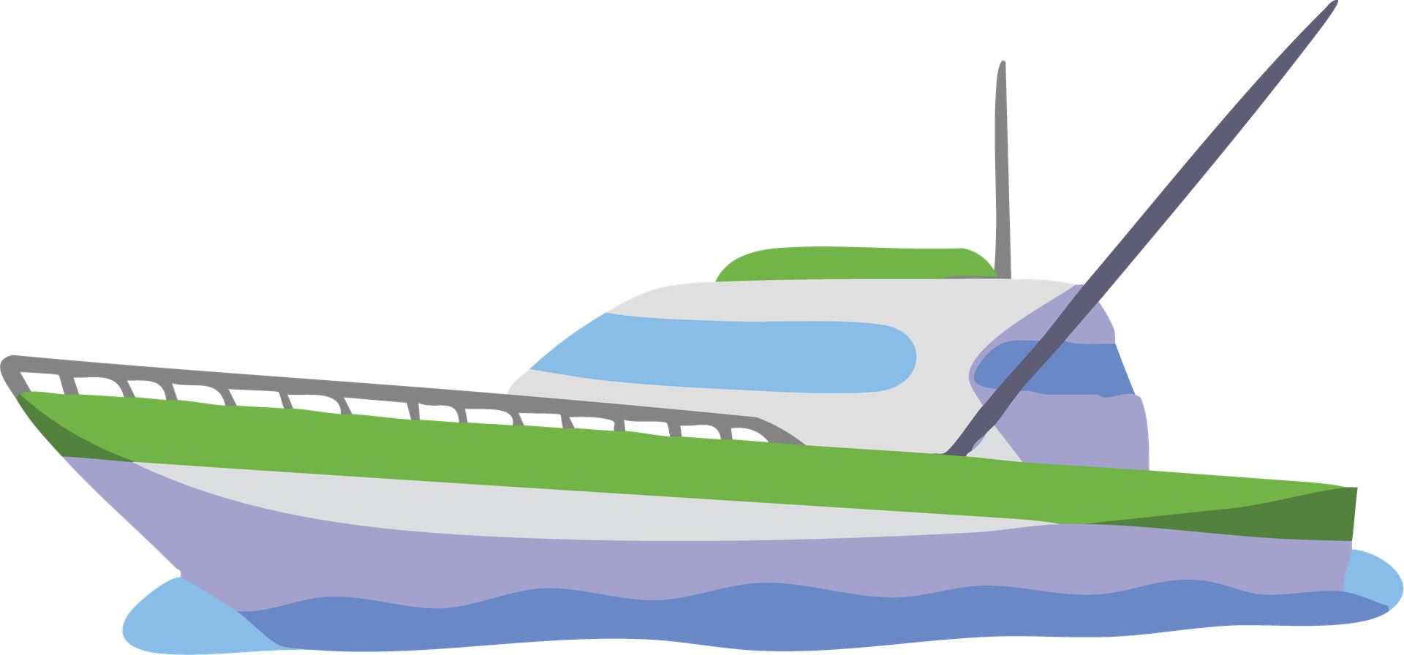
The development of ships spans thousands of years, from simple wooden vessels to advanced steel-engineered designs. Early civilizations relied on ships for fishing and trade, while later innovations enabled long-distance voyages. Maritime advancements transformed exploration, expanded economies, and shaped the course of world history.
A Brief History

Slide 4
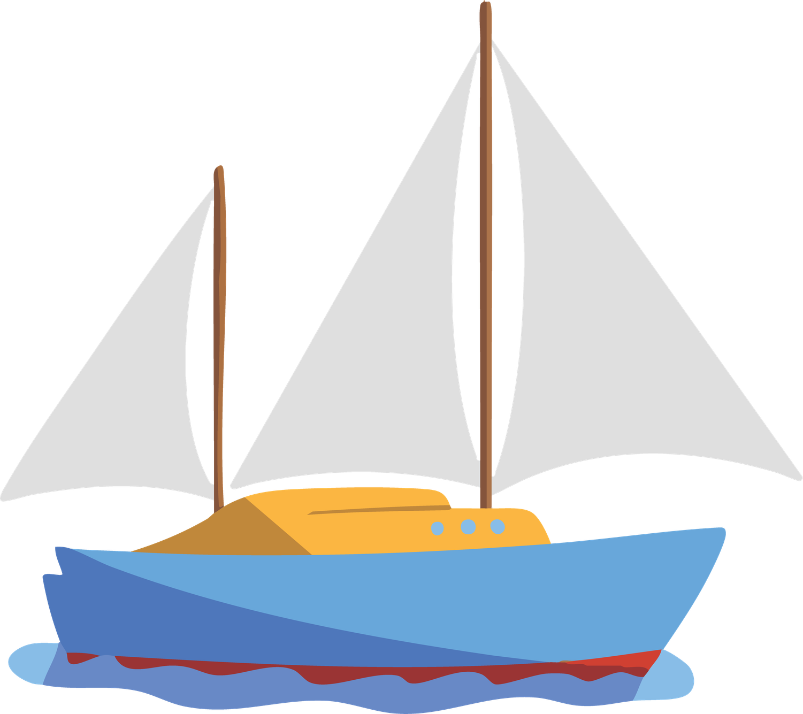
Types Of Ships
Ships are designed for different purposes, including cargo transport, passenger travel, fishing, research, and military operations. Each type features specialized structures and equipment suited to its function. This diversity allows maritime industries to meet a wide range of transportation and operational requirements efficiently.

Slide 5

Ship Construction
Modern shipbuilding combines engineering expertise, durable materials, and advanced technologies. Hull design, structural integrity, and propulsion systems are carefully planned to ensure safety and performance. Shipyards around the world construct vessels capable of operating in diverse marine environments while meeting strict international standards.

Slide 6
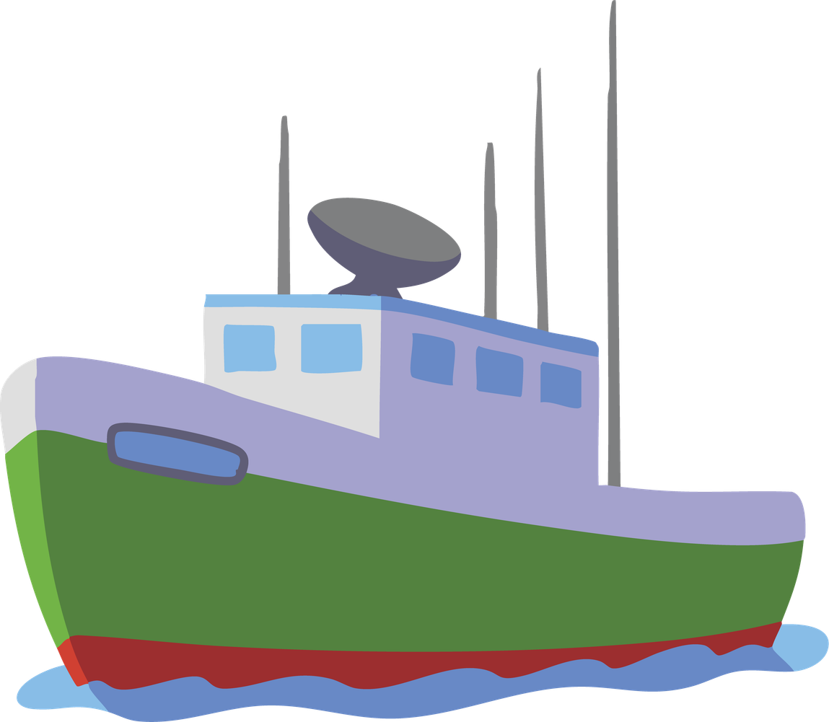
Navigation is essential for safe and efficient maritime travel. Modern ships rely on GPS, radar, communication systems, and digital mapping technologies to determine position and route. These tools help crews avoid hazards, manage weather conditions, and maintain accurate travel schedules across global waterways.
Navigation Systems

Slide 7
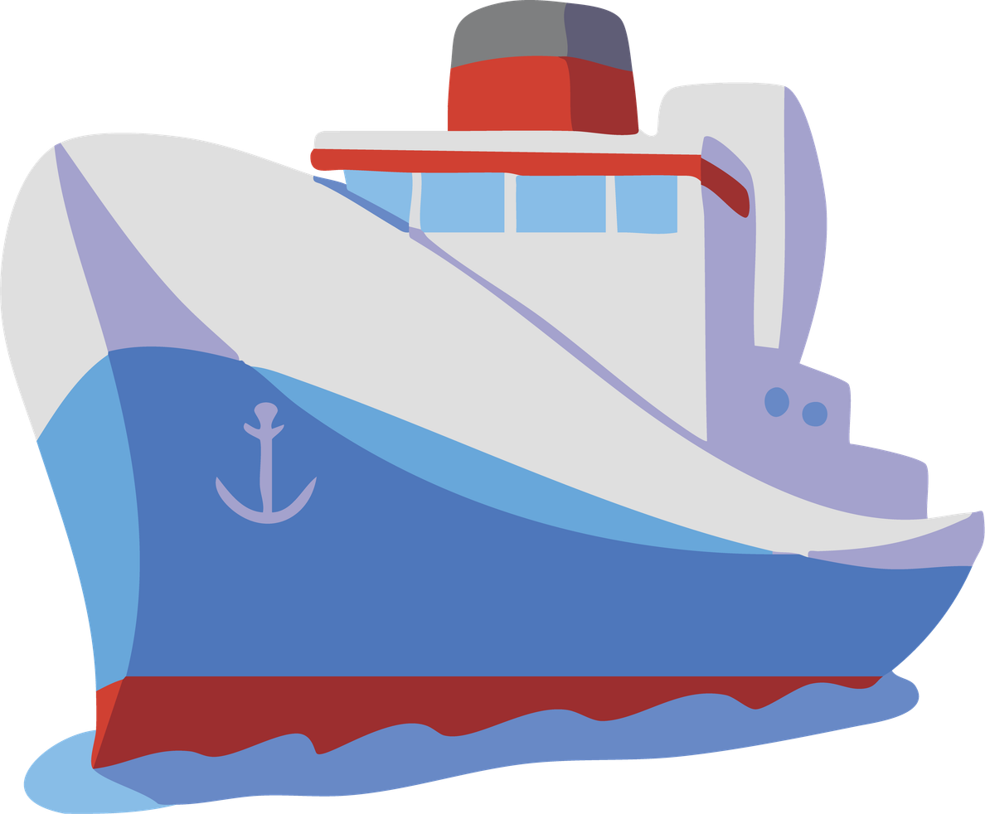
Global Trade And Transport
Ships carry the majority of international trade by volume, transporting raw materials, manufactured goods, and consumer products between continents. Maritime transportation remains one of the most efficient methods for large-scale cargo movement. This global network supports economic growth and international cooperation worldwide.

Slide 8

Life At Sea
Life aboard a ship requires teamwork, discipline, and specialized skills. Crew members perform duties related to navigation, maintenance, safety, and operations. Long voyages present unique challenges and experiences, creating a dynamic environment where cooperation and professionalism are essential for successful maritime missions.

Slide 9

The shipping industry is increasingly focused on reducing environmental impact through cleaner fuels, energy-efficient designs, and sustainable practices. Innovations in propulsion and emissions control help minimize pollution. These efforts contribute to protecting marine ecosystems while maintaining the benefits of global maritime transportation.
Environmental Responsibility

Slide 10
The Future Of Shipping
Advances in automation, digital technology, and sustainable energy are shaping the future of shipping. Smart navigation systems, alternative fuels, and innovative vessel designs promise greater efficiency and safety. As maritime technology evolves, ships will continue serving as vital links in the global economy.

Slide 11
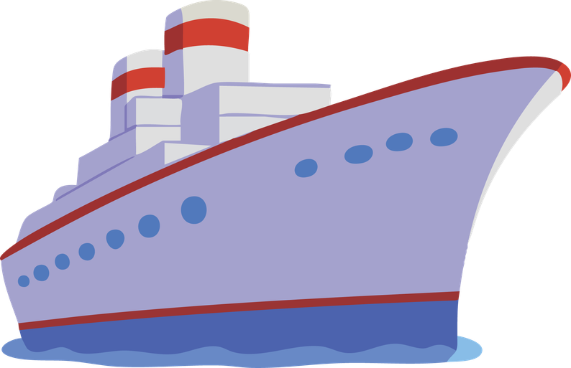
Resource Page

